Slide 1

GITHUB COPILOT
Initiative SVP : Tejas Vadalia Delivery Lead : Abhinav Mittal

Slide 2




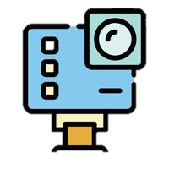

Contents
What is GitHub copilot?
How Copilot works?
Chat GPT v/s Copilot
Comparison with other AI platforms
GitHub Copilot in Action
GitHub co-pilot with VS code

Slide 3
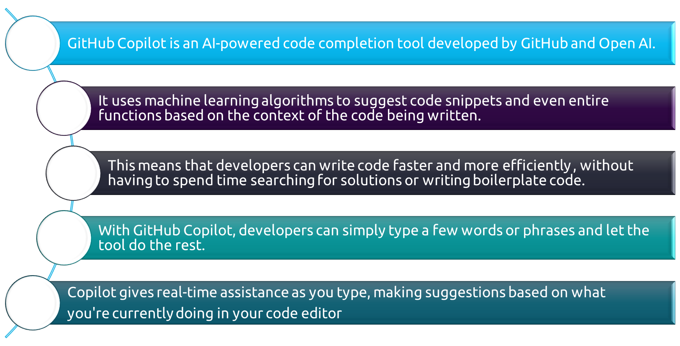


What is GitHub co-pilot ?

Slide 4
HOW GITHUB COPILOT WORKS???
GitHub Copilot uses a combination of deep learning models and natural language processing to understand the context of the code being written.
It analyses the code in real-time and suggests relevant code snippets based on current context. Copilot is built on top of OpenAI's GPT-3 and has access to a massive database of publicly available code that has been combined into a single knowledge base.
The tool is trained on billons of lines of code from open source repositories, which allows it to provide accurate suggestions for a wide range of programming languages and frameworks.
Open AI Codex, a machine learning model that translates natural language into code, powers GitHub Copilot to draw context from comments and code to suggest individual lines and whole functions as you type.
Codex is a version of GPT-3 (Generative Pre-trained Transformer 3) fine-tuned for programming tasks. Some of our favourite applications, like Duolingo, use GPT-3 for grammar correction.
Built from billions of open source code, GitHub Copilot works with popular editors like Visual Studio Code, Visual Studio, and many others as an extension.

Slide 5
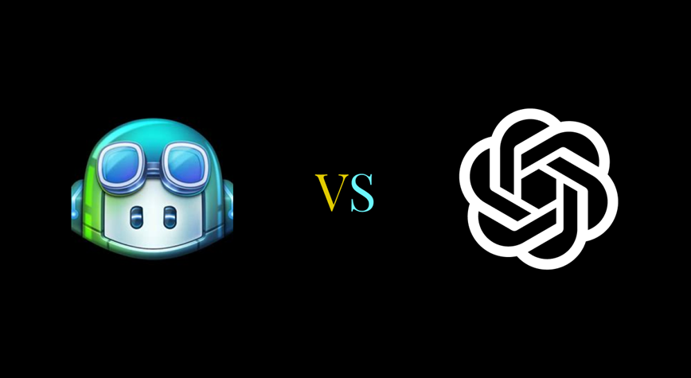

GitHub Copilot V/s Chat GPT
How do they compare???

Slide 6
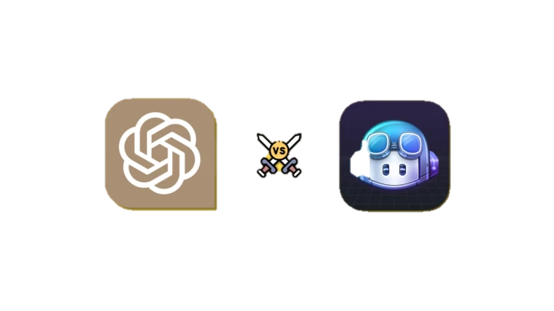

GitHub Copilot and ChatGPT are two generative AI tools that can assist coders in application development.
Copilot, developed by GitHub and OpenAI, focuses specifically on code completion, providing suggestions for code lines or entire functions directly within integrated development environments (IDEs). It is built on OpenAI's language models.
ChatGPT, developed by OpenAI and launched in November 2022, is accessed as a separate tool and is better suited to summarizing complex code or for generating a starting template for a specific coding task
In addition, ChatGPT can provide answers to a broader range of questions outside of typical programming workflows, as it was designed for general language tasks. GitHub Copilot is focused squarely on code completion.
Copilot users can get help directly within popular tools such as Visual Studio, VS Code, and JetBrains IDEs. This also enables it to analyze a large context of code without having to cut and paste short snippets into ChatGPT.
ChatGPT wins on breadth of features and capabilities, while GitHub Copilot wins on the strength and depth of its programming capabilities.

Slide 7



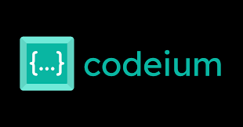
GitHub Copilot vs other AI coding Tools

Slide 8

If you’re in search of a code completion tool that provides maximum flexibility, Tabnine is another option to consider. Similar to GitHub Copilot, Tabnine utilizes advanced machine-learning models.
Both can enhance your software development process by reducing production errors and improving efficiency. Whole-line and full-function code completions are available on both platforms.
Copilot supports cloud mode and offline mode; Tabnine is the only platform that supports offline mode, which allows AI to be run locally without transferring code over a network.
Tabnine offers a free and paid plan, whereas Copilot only offers a paid subscription.

Slide 9
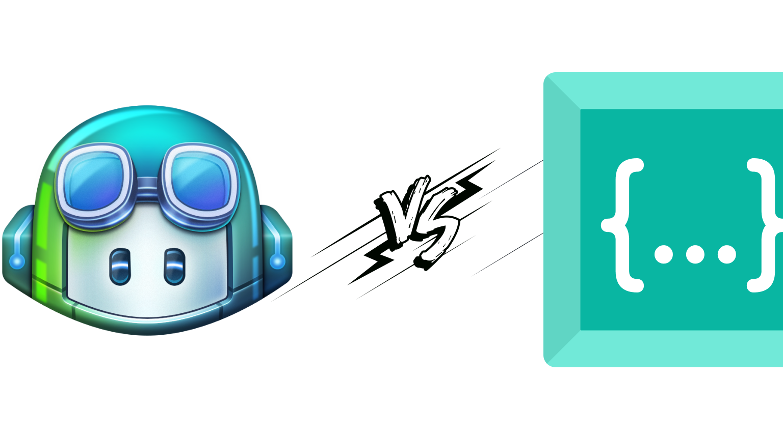

CODEIUM v/s GITHUB COPILOT
Codeium is an AI coding assistant designed to boost developers' productivity by providing code generation and navigation tools. Its primary features, Autocomplete and Search, streamline the coding process and simplify complex tasks, allowing programmers to code much more efficiently.
This approach to code navigation lets you quickly find relevant code snippets, making it easier to track down specific functions or implementations. With Codeium's Search feature, you can spend less time searching and more time focusing on the critical aspects of your project.
Codeium Chat is an impressive feature that allows you to have conversations with a chatbot inside your IDE. It offers interactions like ChatGPT while providing smart suggestions for everyday tasks like adding documentation or refactoring code.
Currently there is no Chat option available in Copilot.
Codeium is free for individual developers , where as Copilot only offers a paid subscription.

Slide 10

COPILOT IN ACTION

Slide 11
STUDY ON GITHUB COPILOT
This new generation AI-powered tool which has the potential to change the way in which developers write code and comes with a number of questions concerning how to effectively exploit them to maximize developers’ productivity, hence to study these factors a team is divided into two groups.
TEAM COPILOT
CONTROLLER TEAM
Project without Copilot.
EXPIREMENTAL TEAM
Implementing and experimenting with Copilot in a project.

Slide 12
Roles and responsibility of Experiment Team
Study and analyse GitHub Copilot
Develop a project using GitHub Copilot.
Track performance and productivity.
Share learnings and benefits
Problems faced during experimentation and solutions.

Slide 13
Study , Analysis and Development of project.
The team first studied about GitHub Copilot, completed the installation and explored how to use the tool.
An angular application was created using GitHub Copilot to explore the potentials and concerns of co-pilot.
A small application was developed using Angular Version 15.1.6 for a Car wash services, where users can order a service for themselves.

Slide 14
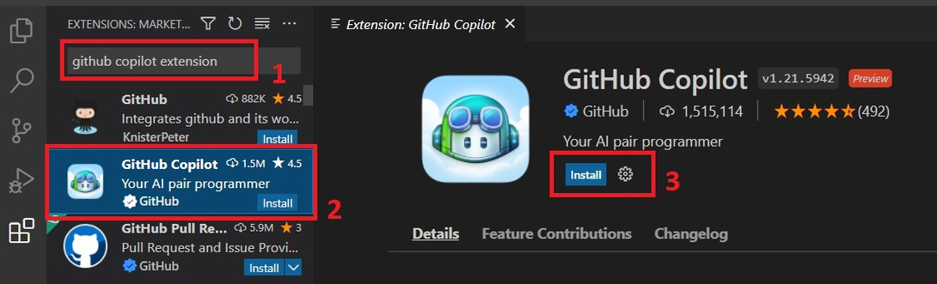
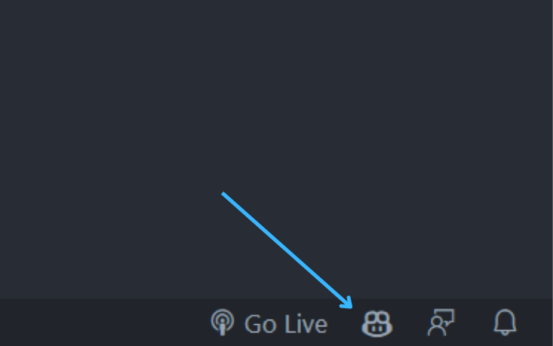
STEP 1 : Install the GitHub Copilot extension.
STEP 2: Sign-In with your GitHub Account.
Open visual studio code, go to the extensions view search for “GitHub Copilot” and click on install.
STEP 3: Start Writing your code. As you type, GitHub Copilot will automatically provide code based on the context of your code.
At the bottom, you will see that GitHub Copilot has been activated.

Slide 15
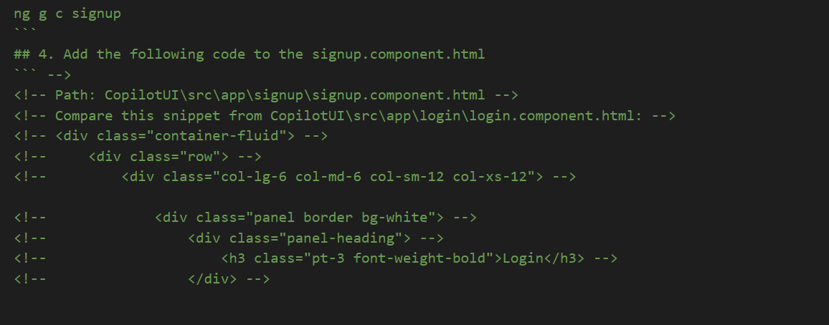
Suggestion given by copilot

Slide 16
Comparing Productivity and Performance with Controller Team

Slide 18

Benefits of GitHub Copilot
Code consistency : GitHub Copilot can help ensure that your project’s code is consistent, making it easier to maintain and debug.
Improved code quality : GitHub Copilot uses machine learning algorithms to generate code, so it can find solutions that you might not have thought of on your own. This can lead to better, more efficient code.
Increased Productivity: Code generation is faster. Helpful while working on large projects. Copilot will significantly help you in learning. It will solve problems and doubts with well commented code.
Reduced development time: Since GitHub Copilot can generate code for you, you can focus on other tasks, like testing, debugging. This can help reduce overall development time and increase your team's efficiency

Slide 19
Potential Drawbacks of Copilot
Code Quality and Accuracy: While Copilot can generate code suggestions, the quality and accuracy of the generated code can vary. The suggestions may not always align perfectly with the desired outcome, and manual review and modifications are necessary to ensure correctness. Relying solely on Copilot's suggestions without careful review can lead to the introduction of bugs or security vulnerabilities.
Compliance and Licensing: When using Copilot, it's important to consider licensing and compliance implications. The generated code snippets may be based on publicly available code, which may have different licensing requirements. Developers need to ensure they have the necessary rights and permissions to use the code generated by Copilot.
License Compatibility: Copilot might suggest code snippets from open-source projects that have different licensing terms than your project. It's crucial to understand the licenses of the code snippets and ensure they are compatible with your project's chosen licenses.
Copilot Server Connection: When using Copilot, sometimes the server doesn’t respond and fails to connect to the Copilot Server.

Slide 20
Solutions
Compliance and Licencing Issue:
Review and Understand Licensing: When using Copilot, it's essential to review and understand the licensing requirements of the generated code. Ensure that the code snippets align with the project's licensing policies and any third-party dependencies. Verify that you have the necessary rights and permissions to use the generated code in your specific project..
Manually Review and Modify Generated Code: Copilot's suggestions should be treated as a starting point rather than a final solution. Developers should manually review and modify the generated code to ensure its correctness, security, and compliance. This review process allows you to validate the licensing and adapt the code to meet your specific requirements

Slide 21
"GitHub Copilot could not connect to server. Extension activation failed"
This error indicates that you either do not have a GitHub Copilot subscription, or there was an error connecting to the GitHub API to request a token to use GitHub Copilot.
To request another token from api.github.com, try signing in and out of GitHub Copilot from your IDE. Once you've logged out, GitHub Copilot will prompt you to sign back in

Slide 22
Future Goals
Resolving the compliance and licensing issue.
Integration of Copilot with Azure Devops.

Slide 23






About Capgemini
Capgemini is a global leader in partnering with companies to transform and manage their business by harnessing the power of technology. The Group is guided everyday by its purpose of unleashing human energy through technology for an inclusive and sustainable future. It is a responsible and diverse organization of 290,000 team members in nearly 50 countries. With its strong 50 year heritage and deep industry expertise, Capgemini is trusted by its clients to address the entire breadth of their business needs, from strategy and design to operations, fuelled by the fast evolving and innovative world of cloud, data, AI, connectivity, software, digital engineering and platforms. The Group reported in 2020 global revenues of €16 billion.
Get the Future You Want | www.capgemini.com
This presentation contains information that may be privileged or confidential and is the property of the Capgemini Group.
Copyright © 2023 Capgemini. All rights reserved.

